Slide 1
Forest Fire Prediction
Assessment Task 2
by
Said Abdullahi
Deakin University

Slide 2
Correlations

Slide 3
Correlations
Most variable are positively correlated with burned area.
RH, wind, and rain are the variable not showing positive correlation.
There are some OUTLIERS in FFMC, rain, and maybe ISI.
We have decided to remove outlier for our chosen variables

Slide 4
Histograms

Slide 5
Distribution
FFMC is negatively skewed, this may be because of outliers.
DMC is slightly positively skewed
DC is also slightly negatively skewed
ISI seems normally distributed, the outlier makes it slightly positively skewed.
Temp is the only one that shows a clear normal distribution. It skewness scores is between 0-0.5. ( see R for skewness scores)
Rain is positively skewed
Area is somewhat normally distributed. Skewness scores is just above 0.5.

Slide 6
Data Transformation
Chosen variables are:
DMC – DMC index from the FWI system
ISI – ISI index from the FWI system
Temp – temperature in Celsius degrees
Wind – wind speed in km/h
Area – the burned area of the forest (in ha). Variable of interest Y
Source: Cortez, P. and Morais (2007)

Slide 7
WHY? WHICH? DATA TRANSFORMATION
DMC is slightly positive skewed. The suitable transformation maybe polynomial with p=0.5. And scaled to 0-1.
ISI is a bit normally distributed. Data transformation used is min max normalization (linear scaling). Cortes and Morais (2007) use linear scaling for all the predictors.
Temp is normally distributed. Z-score standardization maybe a suitable transformation
Wind is slightly normally distributed. Therefore, we use min max normalization.
Area is slightly right skewed . Log transformation is suitable for burned area. Cortes and Morais (2007) also used log transformation.

Slide 8
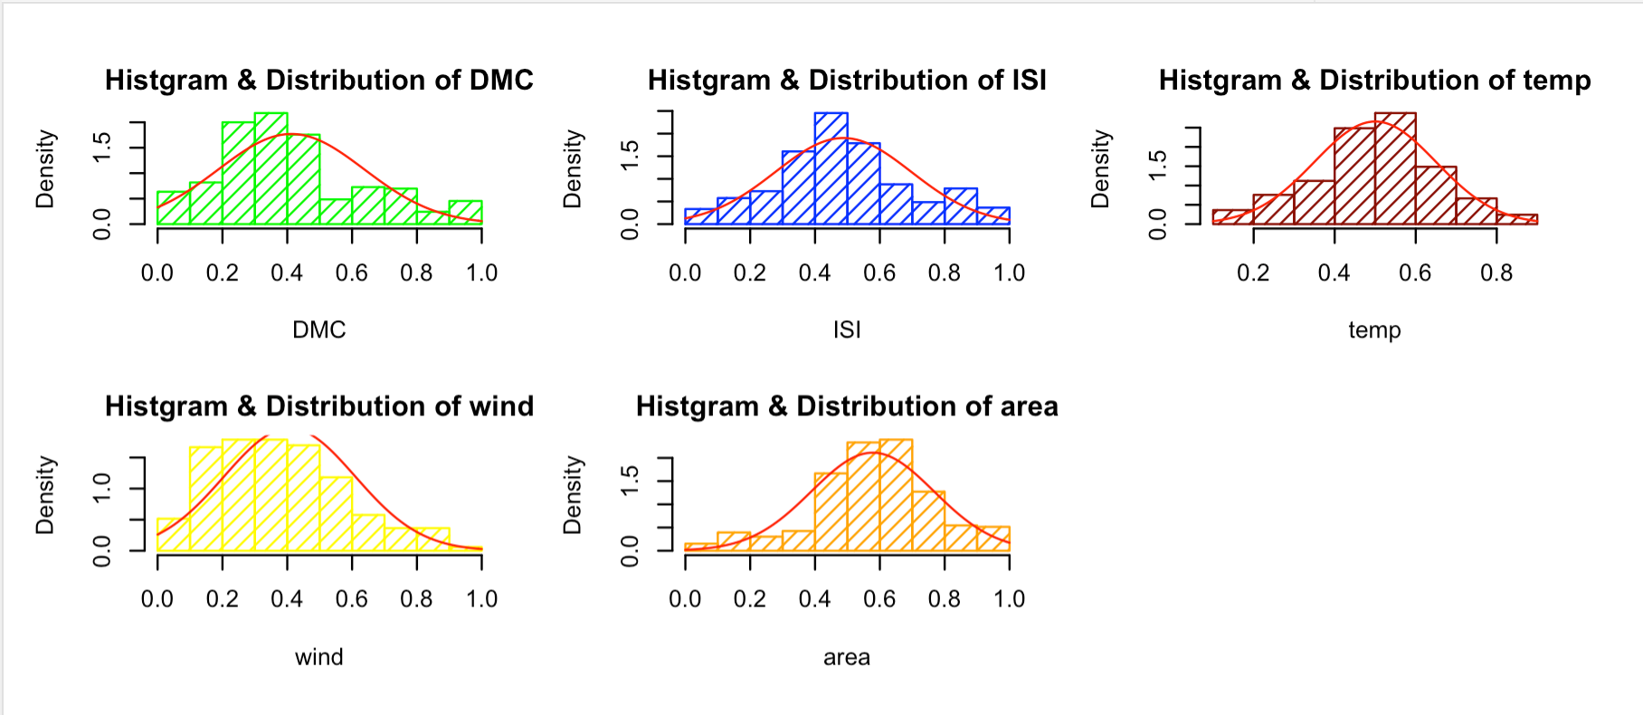
Histogram of Data transformation
We can see that all the data are scaled.
They all seems to be normally distributed after data transformation.
Our data is ready for modelling

Slide 9
Error measures, correlation coefficient, and weights
Weighted Arithmetic Mean (WAM)
RMSE | 0.233092075
Av. abs error | 0.188282718
Pearson correlation | 0.031939482
Spearman correlation | 0.041303624
weights i w_i
1 | 0.202277942
2 | 0.27656165
3 | 0.507847045
4 | 0.013313363
Weighted Power Mean (PM_05) p = 0.5
RMSE | 0.24099162
Av. abs error | 0.195136895
Pearson correlation | 0.009550759
Spearman correlation | 0.035738704
weights i w_i
1 | 0.128185593
2 | 0.196113878
3 | 0.661620905
4 | 0.014079624

Slide 10
Error measures, correlation coefficient, and weights
Weighted Power Mean (QM) p = 2
RMSE | 0.221665526
Av. abs error | 0.176741198
Pearson correlation | 0.036979217
Spearman correlation | 0.032175186
weights i w_i
1 | 0.192365046
2 | 0.228444545
3 | 0.472804165
4 | 0.106386245
Order Weighted averaging function (OWA)
RMSE | 0.214146607
Av. abs error | 0.16753949
Pearson correlation | 0.045597009
Spearman correlation | 0.032977282
weights i w_i
1 | 0
2 | 0.245026186
3 | 0.265892223
4 | 0.489081591

Slide 11
OWA weights (best fitting)
Interestingly, OWA the fitted weights allocate most to wind(w4 here).
Second is temperature with 0.27
It is surprising that DMC weight is 0.
Surprising, we would expect moisture content of shallow and deep layers to affect fire intensity.

Slide 12
Importance of each variable
The dataset consist of three components:
Weather observations or forecasts – Rain, Wind, temp
Fuel Moisture Codes – FFMC, DMC, DC
Fire Behaviour Indexes – ISI
DMC and DC represents moisture content of shallow and deep organic layers. Affect fire intensity
ISI is a score that correlates with fire velocity spread
temp - temperature in Celsius degrees
wind - wind speed in km/h
area - the burned area of the forest (in ha)

Slide 13
Best fitting model
The fitting functions to learn the parameters for
A weighted arithmetic mean (WAM),
Weighted power means (WPM) with p = 0.5,
Weighted power means (WPM) with p = 2,
An ordered weighted averaging function (OWA).
OWA is best fitting model because it has the lowest RMSE and average absolute error. It is 0.21 and 0.17 respectively.

Slide 14
Results
Compare the predicted Y with actual Y.
Predicted Y: 0.007070659 ≅ 0.01
Actual Y: 0.0146 ≅ 0.01

Slide 15
Limitation
As stated by Cortez and Morais (2007) it will be harder to predict larger fires.
Neural Network would perform better done our analysis
Large fires are rare event, so that needs to be taken into account

Slide 16
References
Cortez, P. and Morais, A. A Data Mining Approach to Predict Forest Fires using Meteorological Data. In J. Neves, M. F. Santos and J. Machado Eds., New Trends in Artificial Intelligence, Proceedings of the 13th EPIA 2007 - Portuguese Conference on Artificial Intelligence, December, Guimarães, Portugal, pp. 512-523, 2007. APPIA, ISBN-13 978-989-95618-0-9, available at http://www3.dsi.uminho.pt/pcortez/fires.pdf. "UCI Machine Learning Repository: Forest Fires Data Set". Archive.ics.uci.edu. N.p., 2017, http://archive.ics.uci.edu/ml/datasets/forest+fires.

Slide 17
R Core Team (2021). R: A language and environment for statistical computing. R Foundation for Statistical Computing, Vienna, Austria. URL https://www.R-project.org/.

